Slide 1

RESEARCH MODEL
Notes:
NOTE:
To change the image on this slide, select the picture and delete it. Then click the Pictures icon in the placeholder to insert your own image.

Slide 2
Introduction
We have taken a stock market data of a pharmaceutical company “glenmark” and have analyzed the pattern using last 5 year data.
We have used Neural Network which is used for forecasting.

Slide 3
PROBLEM DEFINITION
Develop an Analysis model based on ML for companies in a particular sector e.g. oil and gas; banking, Pharma company, TMT,etc. You could take an existing model and enable it with AI

Slide 4
SCOPE
We can use the same neural network model to forecast & prediction the results of all other companies.

Slide 5
Literature Survey
TIME SERIES
It is series of correlation observation made over time.

Slide 6
Methodology Applied
The motivation for the development of neural network technology stemmed from the desire to develop an artificial system that could perform "intelligent" tasks.
A neural network acquires knowledge through learning.
A neural network's knowledge is stored within inter-neuron connection strengths known as synaptic weights. So we have made 73 connections in our network.
The true power and advantage of neural networks lies in their ability to represent both linear and non-linear relationships and in their ability to learn these relationships directly from the data being modeled

Slide 7
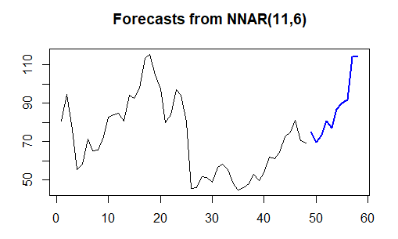
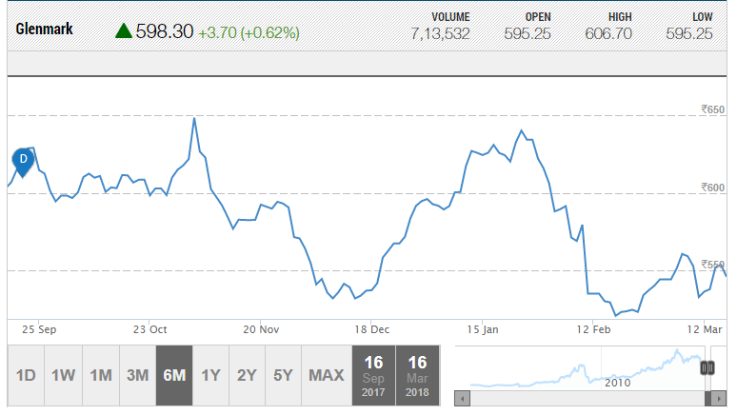
Result
Our Result
Actual Result by moneycontrol.com

Slide 8
THANK YOU

